Slide 1
Intro to rpi 19, 20 Mar 2013 Zhu Wanjing, Wong Song Sing
Features & Possibilities
Resources
Course coverage
Pins & Interfaces
Lab setup
Preparations
DO NOT power up your rpi yet

Slide 2
rpi Model B Features
Single board computer (sbc) @USD$35
5V in (onboard 3.3V can provide up to 50mA)
700MHz - 1GHz
512M RAM
Linux – raspbian (a port of Debian)
GPU with HDMI
Ethernet
USB – Can add Wifi, uart, camera, …
GPIO – parallel port pins, I2C, SPI
Pi for Python
Model A:
256M RAM
No Ethernet, USD$25
Don’t have:
real-time clock (but would sync to internet),
ADC
real-time features

Slide 3
Possibilities
Networking
Webserver, PHP, …
Database
Graphic – GPU, 3D, image
IO
SW: C, C++, go, bash, python, perl, lua, scratch …
Multitasking
Some projects
http://elinux.org/RPi_Projects
http://pingbin.com/2012/12/30-cool-ideas-raspberry-pi-project/
http://lifehacker.com/5978871/ten-more-awesome-projects-for-your-raspberry-pi
xbmc http://wiki.xbmc.org/index.php?title=Raspberry_Pi
RaspPBX (Asterisk) http://www.raspberry-asterisk.org/
…

Slide 4
Some Web Resources
Home
http://www.raspberrypi.org/
OCR Resources - getting started tutorial …
http://www.ocr.org.uk/qualifications/by-subject/ict/raspberry-pi/
Take are look at the “Raspberry Pi Resources Links” to other useful places
Education manual
http://downloads.raspberrypi.org/Raspberry_Pi_Education_Manual.pdf
youtube:
http://www.youtube.com/user/raspberrypitutorials
http://www.youtube.com/user/raspberrypibeginners
MagPi - useful free magazine: http://www.themagpi.com/
Useful libraries
wiringPi - useful C library for gpio, ... (arduino like)
https://projects.drogon.net/raspberry-pi/
Quick2wire - python 3 modules for GPIO, i2c and spi
http://quick2wire.com/
Technical Tutorials
http://elinux.org/RPi_Tutorials

Slide 5
Books
Raspberry pi user guide (Gareth Halfacree and Eben Upto 2012)
Getting Started with Raspberry Pi (Matt Richardson & Shawn Wallace 2012) - Read online http://it-ebooks.info/read/1354/
Learn Raspberry Pi with Linux (Peter Membrey & David Hows - 2012)
Learning Raspberry Pi (Erik Bartmann 2013)
Raspberry Pi Projects (Andrew Robinson and Mike Cook – 2013)
Practical Raspberry Pi (Brendan Horan – 2013)
Programming the Raspberry Pi: Getting Started with Python (Simon Monk – 2012)
Raspberry Pi For Dummies (Sean McManus and Mike Cook)
Raspberry Pi Home Automation with Arduino (Andrew K. D 2013)
Raspberry Pi in Easy Steps (Mike McGrath 2013)
Raspberry Pi Hacks: Tips and Tools for Making Things with the Inexpensive Linux Computer (Ruth Suehle and Tom Callaway 2013)

Slide 6
Arduino vs RPi
Arduino or …
RPi
Simpler to get working
Simpler embedded system with easy-to-develop sw
Support is available virtually everywhere
Perfect for controlling hardware (robotics)
different kits and shield’s available
<0.5 W or lower at uA with low clock
Less simpler
Fully fledged computer running Linux - possibilities
Limited support; should increase over time
A powerful GPU and can handle HD content
Few kits are available presently
~3.5 W is comparatively higher
http://www.rpiblog.com/2012/09/arduino-vs-raspberry-pi.html

Slide 7
Coverage
Day 1 AM: Getting Started
Intro & Resources
Connections, start-up, console, GUI, maintenance, installations, commands
Day 1 PM: C Programming
Makefile
wiringPi library
serial port, i2c, spi
lcd, keypad
socket programming ...
Multitasking
Day 2 AM: Python Basics
data
functions
multiple files
Day 2 PM: More Python
GUI - tkinter
i2c, spi
serial port
network programming
multitasking

Slide 8
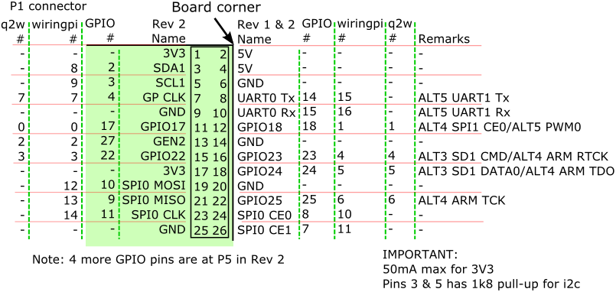
GPIO Pins
GPIO, wiringpi and quick2wire pin numbering
Pins are not 5V tolerant! 3.3V only !
Use wiringpi and q2w pins 0 to 7
For rpi revision 1 header pins:
3 – SDA0 / GPIO0
5 – SCL0 / GPIO1
13 – PCM Dout / GPIO21
UART0 Tx and Rx are used for use for terminal console.
DO NOT add pull-up for your i2c devices !

Slide 9
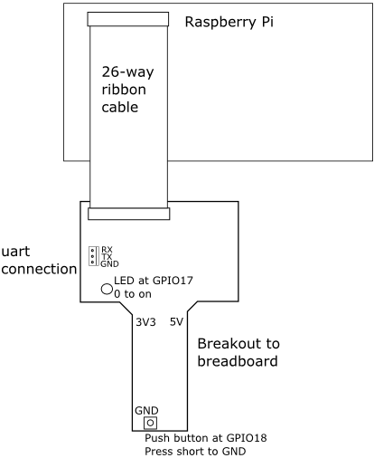
Breakout Board Connection

Slide 10
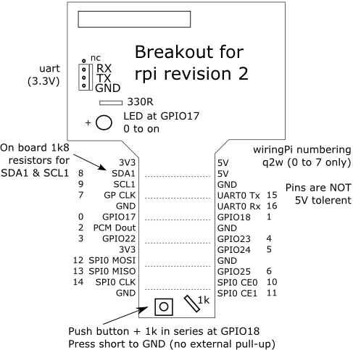
Breakout Board Details

Slide 11
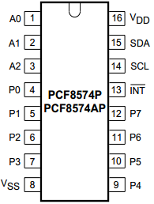
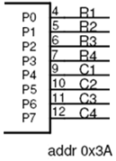
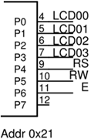
Interfaces
All are interfaced through PCF8574 or PCF8574A IO expander except accelerometer
keypad
- IO expander pins are open-drain type & Use 5V supply
- Can sink but cannot source
- For input, write 1 to the pin to cut-off transistor
IO expander pins
LEDs & Switches
P0
P1
P2
P3
P4
P5
P6
P7
4 DIP
switches
leds
5V
SDA
SCL
GND
4 LEDs
5V
SDA
SCL
GND
DIP switches
i2c addr: 0x3b
Accelerometer ADXL345
Use 3V3 ONLY
i2c addr: 0x3a
1 VDD 3V3
2 GND GND
3 CS 3V3
4 VS 3V3
5 INT1
6 INT2
7 SDO 3V3 - addr 0x1d
GND - addr 0x53 (use this)
8 SDA SDA
9 SCL SCL
1
9
LCD
5V
SDA
SCL
GND
LCD
i2c addr: 0x21

Slide 12
Proposed Breadboard Layout
IMPORTANT:
ADXL345 uses 3V3.
The rest use 5V.
Create a bus of i2c signals:
5V
SDA
SCL
GND
LCD
3V3 ONLY !

Slide 13
Our Lab Network
Router
Subnet name: prj-06-03a
Student point: can access internet, staff VPN
Our laptop and rpi’s are connected through wired ethernet
Turn off your wifi & use only wire connection
IP address given to your computer and rpi by router through DHCP
Each rpi to have a unique host names rpi-npeceXX
Hardware Setup & Kernel Image

Slide 14
Preparations
1. Install 32-bit Java run-time environment
If you already has java on your machine, do step 2 and 3 below. If not ok, …
Download 32-bit versions to run java vnc viewer
http://java.com/en/download/manual.jsp
Path to java.exe? E.g. C:\Program Files (x86)\Java\jre7\bin\java.exe
Not sure if 64-bit version would work.
2. Download & unzip java vnc viewer 2.6
https://gpxsvr5.np.edu.sg/apps4/ece/npubece.nsf/page/rpi-intro
Unzip into folder, e.g. D:\vnc
FYI: http://www.tightvnc.com/ [lastest version 2.6.2 has a bug with Ctrl key]
3. Batch file vncv.bat to run vnc viewer, e.g.
"C:\Program Files (x86)\Java\jre7\bin\java.exe" -jar D:\vnc\tightvnc-jviewer.jar
4. Download putty.exe
http://www.chiark.greenend.org.uk/~sgtatham/putty/download.html
We will use it to
connect to rpi through laptop serial port
connect to rpi through SSH using Ethernet
DO NOT power up your rpi yet

